Slide 1
Milestone 2
Presented by: Sulfur Tungsten Silver
Evandro Valente - ENES100 - Section 0601

Slide 2
Meet the team:
Michael Tao (Group Leader and computer sub group leader)
Isaac Lee (Mechanics sub group leader)
Ken Daniel (Structural sub group leader)
Spencer Mical (Chemical sub group leader)
John Murdock (Electrical sub group leader)
Stephen Waak (Chemical team)
Eliav Winton (Chemical and electrical team)

Slide 3
Presentation overview
CAD diagrams
Mass estimation table
Torque calculations and moment diagram
Motor and battery selection
Mission specific details:
Neutralization calculations
Sensor capabilities
Actuators
Circuit diagram
Control algorithm
Bookkeeping
Bill of materials
Gantt

Slide 4
Mission Overview:
Basic objectives:
Navigate the O.S.V. to within 250 mm of the polluted water source.
Measure the pH of the water source.
Communicate the pH of the water source back to command, within 0.3 units.
Advanced objectives:
Collect a 10-15 mL sample of the water source, prior to neutralization.
Neutralize the pH of the pool by returning the pool pH level to a range of 6-8, and transmit that the pool’s pH was neutralized, back to command.

Slide 5
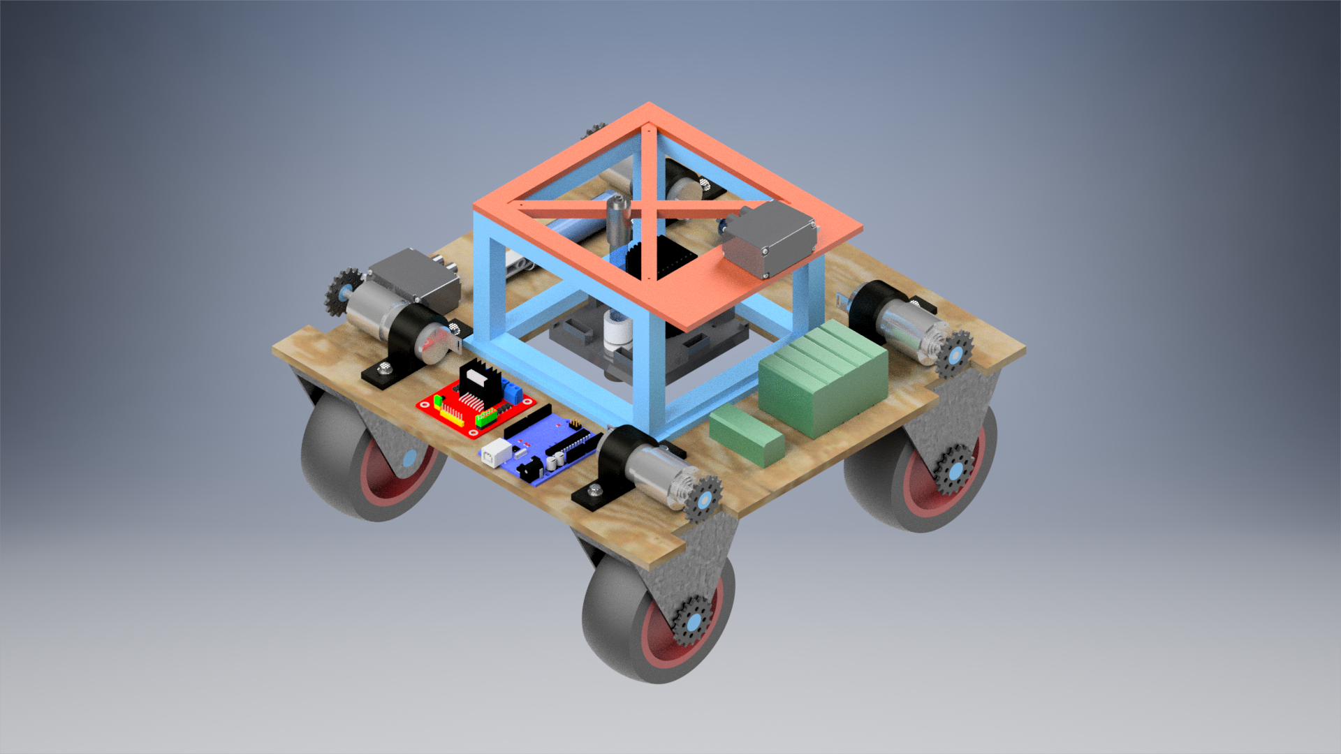
Isometric view of the O.S.V.
Vex platform lifter
Instrument Platform
12v DC Motor
L298 Dual H-Bridge
12v and 7.2v battery
Arduino

Slide 6
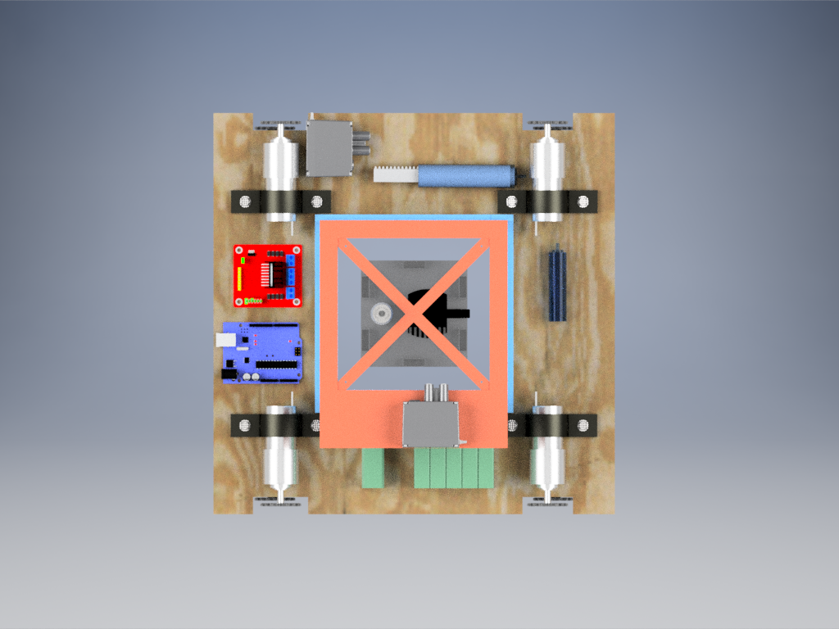
Base syringe
Base dispensing motor
Sampling syringe

Slide 7
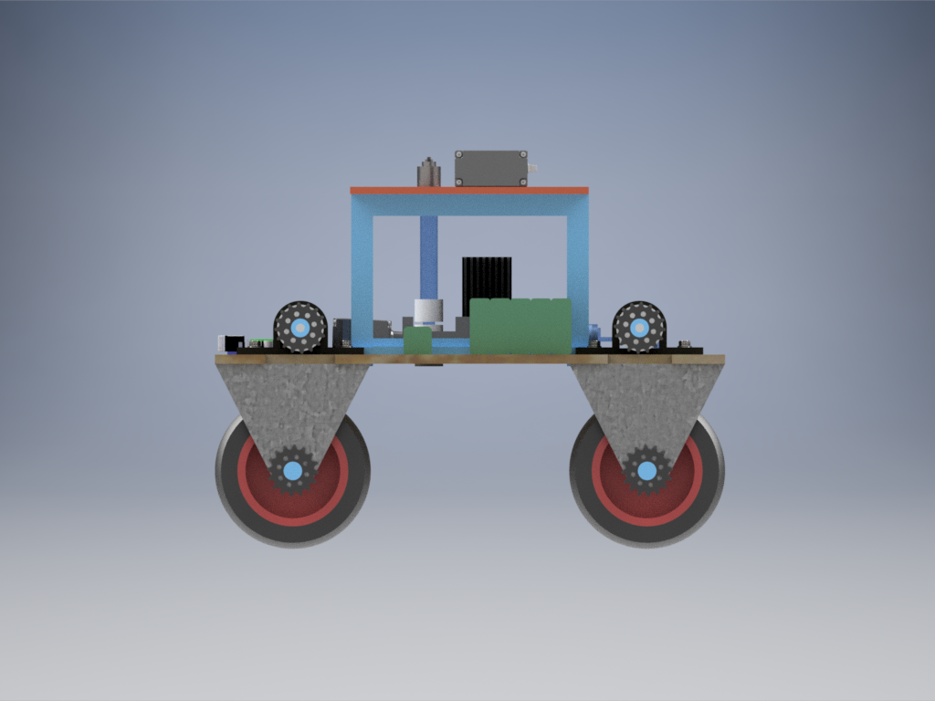
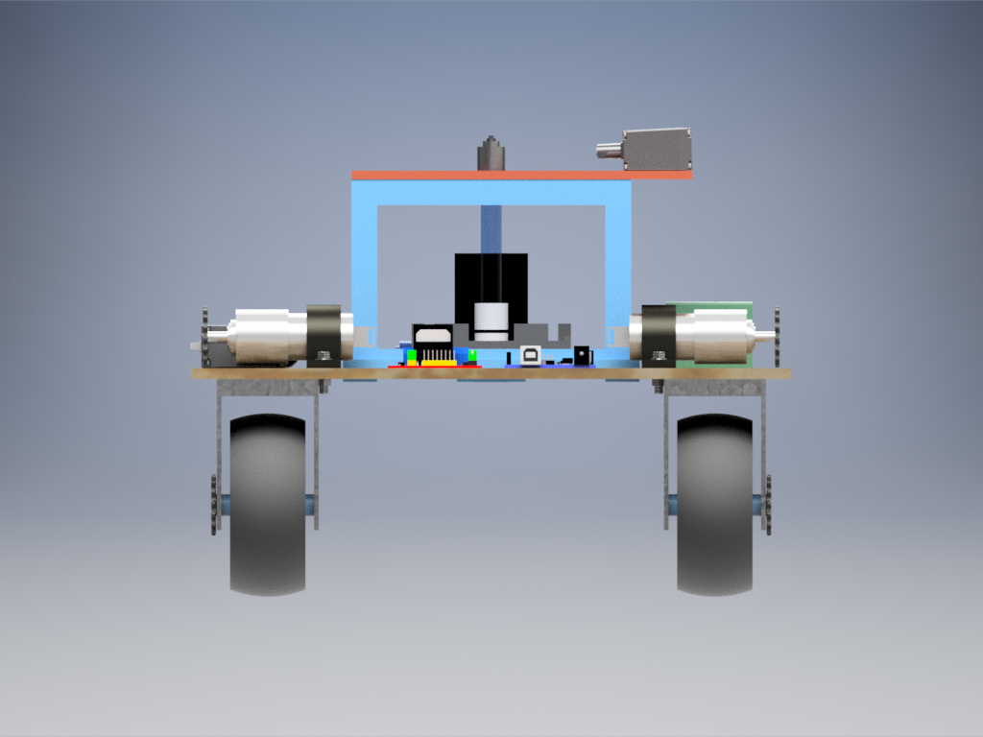
Side and front views

Slide 8
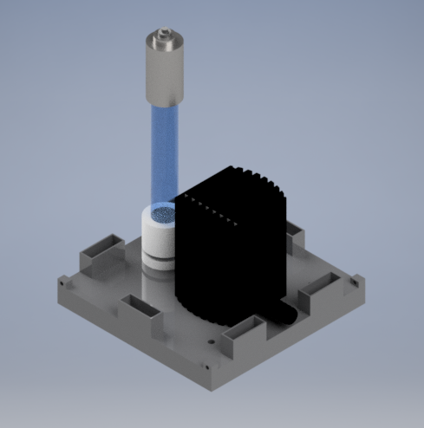
Instrument platform
pH meter
Pump to agitate solution
Couterbalance slots

Slide 9
Mass Estimation Table of the O.S.V.
Item | Weight (g) | Quantity | Total weight
12V battery | 280 | 1 | 280
7.2v battery | 125 | 1 | 125
Vex Motor | 87.1 | 2 | 174.2
Sprockets | 2.8 | 8 | 22.4
Base Solution | 150 | 1 | 150
Wooden base | 400 | 1 | 400
Pump | 50 | 1 | 50
pH monitor | 20 | 1 | 20
Lifting Platform | 33.8 | 1 | 33.8
Arduino | 20 | 1 | 20
Wheels | 100 | 4 | 400
Motor | 300 | 4 | 1200
Platform counterbalance | 50 | 5 | 250
Total |  |  | 3125.4

Slide 10
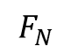
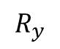
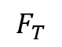
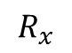
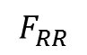
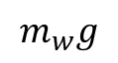
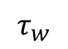
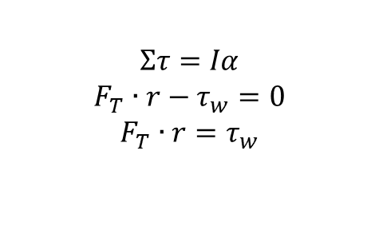
Free body diagram of wheel over sand
$$Στ=Iα$$
$$F_{T}∙r−τ_{w}=0$$
$$F_{T}∙r=τ_{w}$$
$$R_{y}$$
$$τ_{w}$$
$$R_{x}$$
$$m_{w}g$$
$$F_{RR}$$
$$F_{T}$$
$$F_{N}$$
Resultant of $F_{N}$ and $F_{RR}$ points directly at wheel center

Slide 11
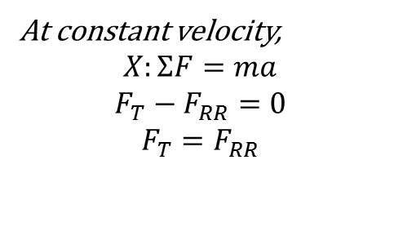
Free body diagram of wheel over sand
At constant velocity,
$$X:ΣF=ma$$
$$F_{T}−F_{RR}=0$$
$$F_{T}=F_{RR}$$
$$R_{y}$$
$$τ_{w}$$
$$R_{x}$$
$$m_{w}g$$
$$F_{RR}$$
$$F_{T}$$
$$F_{N}$$
$τ_{w}$, $R_{y}$, $R_{x}$, $m_{w}g$ are internal forces

Slide 12
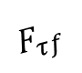
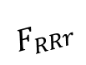
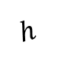
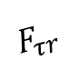
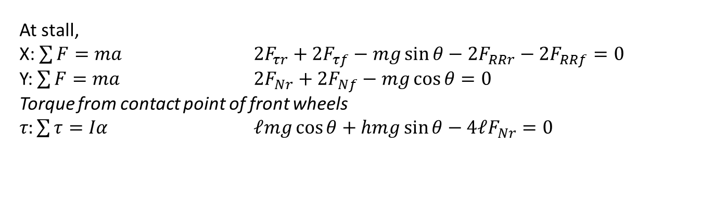
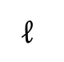
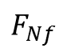
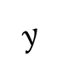
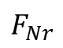
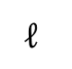
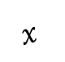
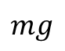
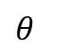
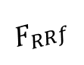
Model used to derive calculations
$$ℓ$$
$$ℓ$$
$$F_{RRf}$$
$$F_{τf}$$
$$F_{RRr}$$
$$y$$
$$h$$
$$F_{τr}$$
$$x$$
$$mg$$
$$F_{Nf}$$
$$θ$$
$$F_{Nr}$$
At stall,
X: $\sum{F}=ma$ $2F_{τr}+2F_{τf}−mg\sin{θ}−2F_{RRr}−2F_{RRf}=0$
Y: $\sum{F}=ma$ $2F_{Nr}+2F_{Nf}−mg\cos{θ=0}$
Torque from contact point of front wheels
𝜏$:\sum{τ}=Iα$ $ℓmg\cos{θ}+hmg\sin{θ}−4ℓF_{Nr}=0$

Slide 13
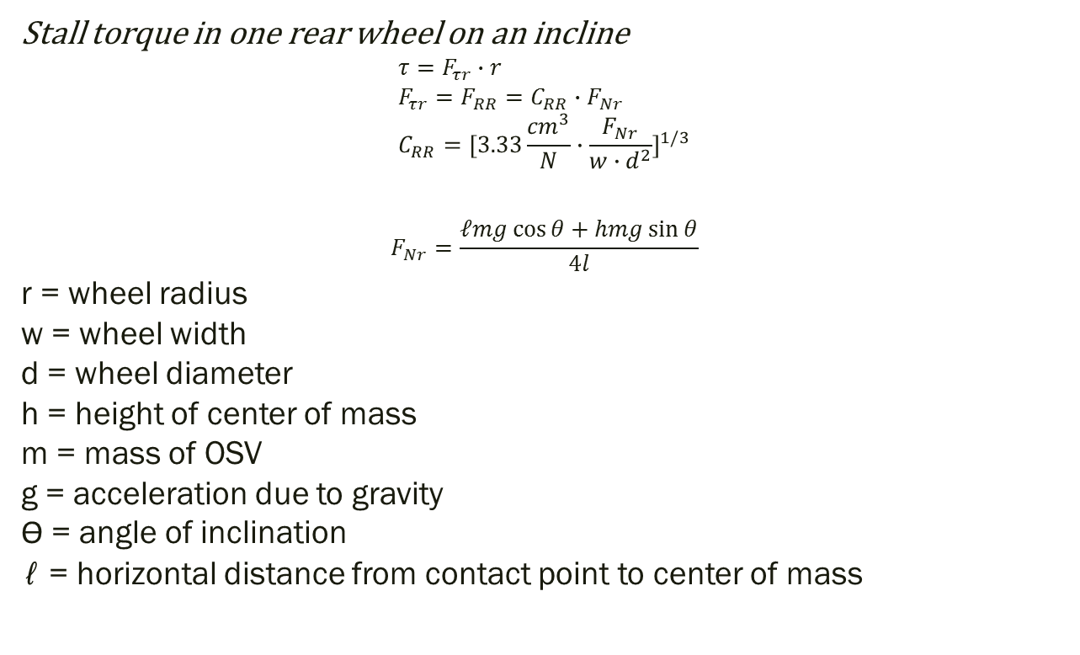
Stall torque in one rear wheel on an incline $$τ=F_{τr}∙r \\ F_{τr}=F_{RR}=C_{RR}∙F_{Nr} \\ C_{RR}={[3.33\frac{{cm}^{3}}{N}∙\frac{F_{Nr}}{w∙d^{2}}]}^{1/3}$$
$$F_{Nr}=\frac{ℓmg\cos{θ}+hmg\sin{θ}}{4l}$$ r = wheel radius w = wheel width d = wheel diameter h = height of center of mass m = mass of OSV g = acceleration due to gravity ϴ = angle of inclination ℓ = horizontal distance from contact point to center of mass

Slide 14
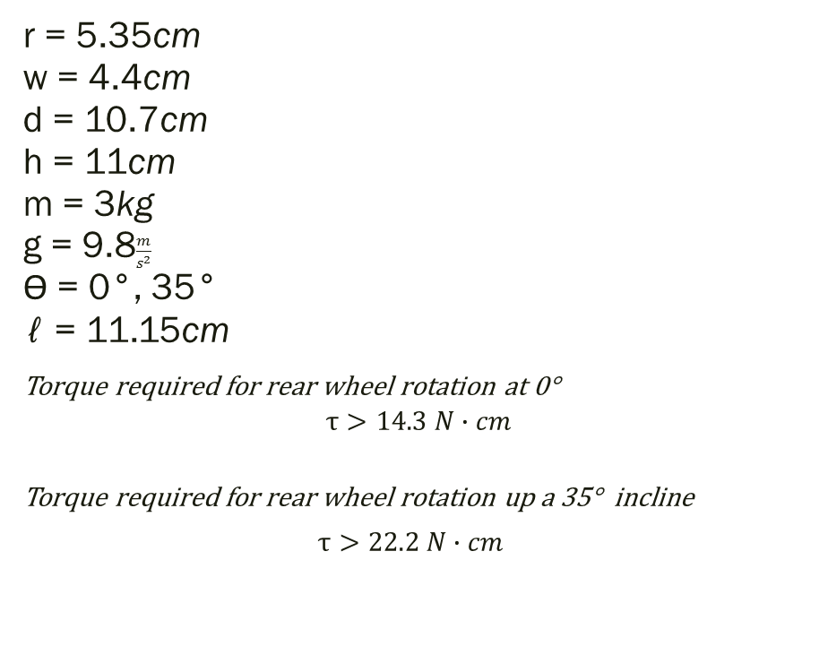
r = 5.35cm w = 4.4cm d = 10.7cm h = 11cm m = 3kg g = 9.8$\frac{m}{s^{2}}$ ϴ = 0°, 35° ℓ = 11.15cm
Torque required for rear wheel rotation at 0°
$$τ>14.3 N∙cm$$
Torque required for rear wheel rotation up a 35° incline
$τ>22.2 N∙cm$

Slide 15
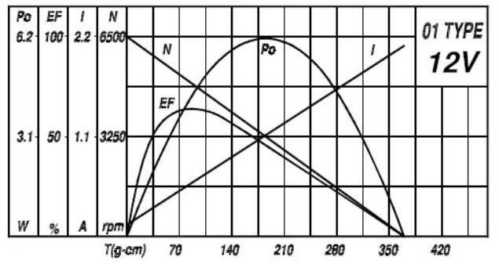
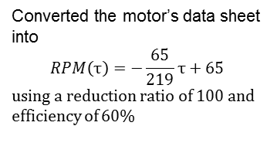
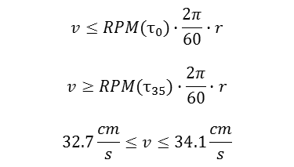
Converted the motor’s data sheet into
$$RPM\left(τ\right)=−\frac{65}{219}τ+65$$
using a reduction ratio of 100 and efficiency of 60%
$$v≤RPM(τ_{0})∙\frac{2π}{60}∙r$$
$$v≥RPM(τ_{35})∙\frac{2π}{60}∙r$$
$$32.7\frac{cm}{s}≤v≤34.1\frac{cm}{s}$$

Slide 16
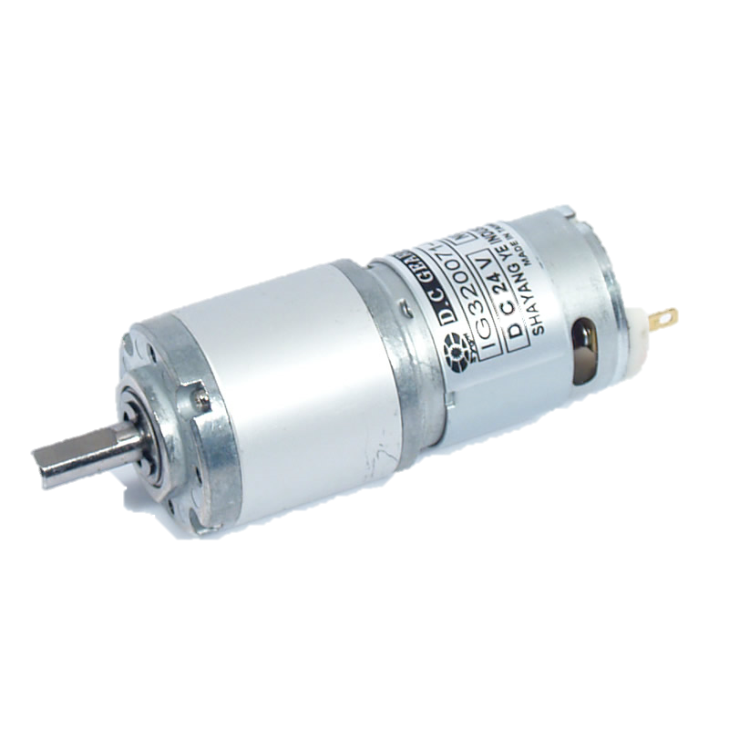
Drive Motor selection
IG32 12VDC 053 RPM Gear Motor
Rated Speed: 53RPM
Rated Torque: 98.4Ncm
Stall Torque: 294.08Ncm
No load current: 150mA
Benefits:
Planetary gearbox
Slow rotation for controlled movement

Slide 17
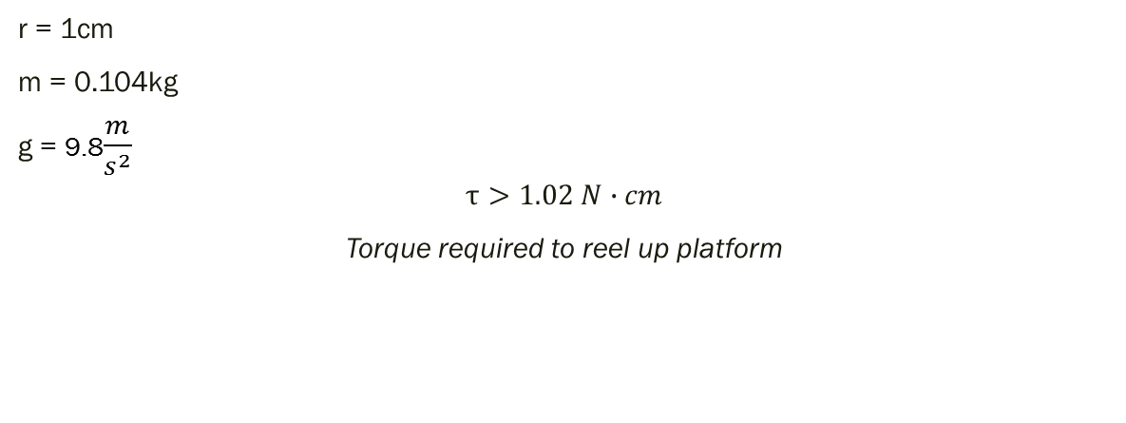
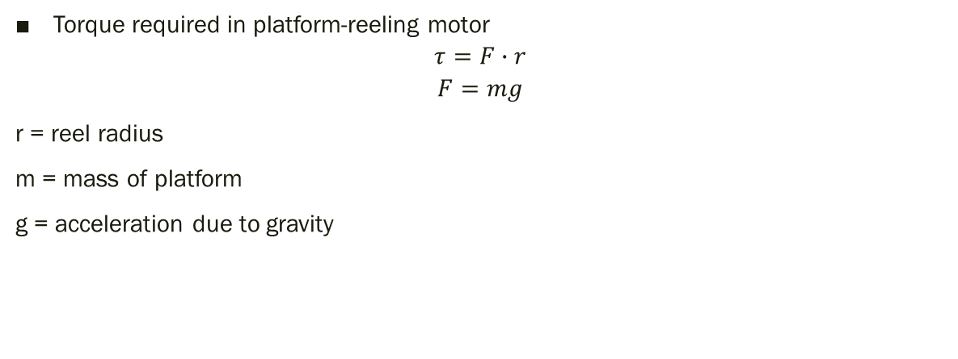
Platform motor calculations
Torque required in platform-reeling motor
$$τ=F∙r$$
$$F=mg$$
r = reel radius
m = mass of platform
g = acceleration due to gravity
r = 1cm
m = 0.104kg
g = 9.8$\frac{m}{s^{2}}$
$$τ>1.02 N∙cm$$
Torque required to reel up platform

Slide 18
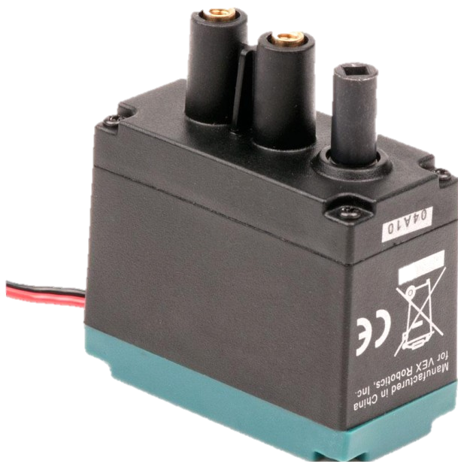
Platform motor
Vex 2 wire motor 393 7.2v
Rated Speed: 100 rpm
Stall Torque: 167Ncm
No load current: 370mA
Benefits:
Very high torque (Enough for all circumstances)
Serviceable and comes with gear replacements
Fits standard Vex components

Slide 19
Motor Current Draw
Minimum $τ$ at 0°
$$τ_{0}>14.3 N∙cm$$
$$i_{0}>318mA$$
Maximum $τ$ at 35°
$$τ_{35}<22.2 N∙cm$$
$$i_{35}<411mA$$
$$318mA<i<411mA$$
Motor Current
i = mτ + b
Current: i
Torque: τ
No load current: b = $150mA$
Motor constant:
m = $\frac{530mA}{45Ncm}=$ $11.78\frac{mA}{Ncm }$

Slide 20
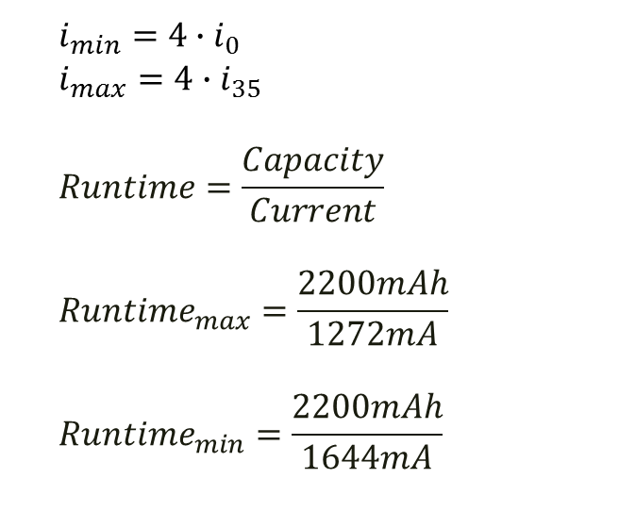
12V Battery
$i_{min}=4∙i_{0}$
$$i_{max}=4∙i_{35}$$
$$Runtime=\frac{Capacity}{Current}$$
$${Runtime}_{max}=\frac{2200mAh}{1272mA}$$
$${Runtime}_{min}=\frac{2200mAh}{1644mA}$$
Motor Battery
Voltage: 12V Dc
Battery Capacity: 2,200mAh
100% Runtime
$$1.3 hr<runtime<1.7 hr$$
60% Runtime
$$0.8 hr<runtime<1.0 hr$$

Slide 21
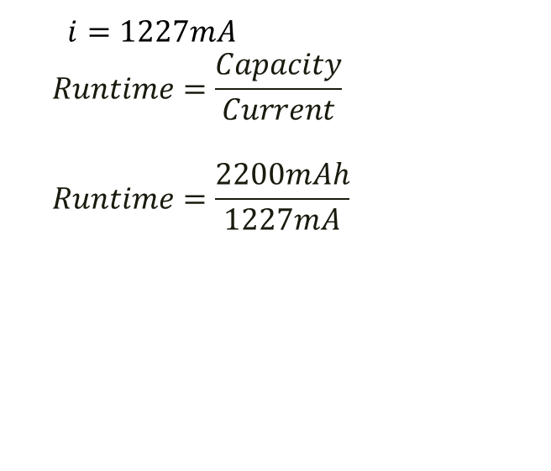
7.2 V Battery
$$i=1227mA$$
$$Runtime=\frac{Capacity}{Current}$$
$$Runtime=\frac{2200mAh}{1227mA}$$
Battery for the Romeo
Voltage: 7.2 V Dc
Battery Capacity: 2,200 mAh
Total current of OSV functions: 1227 mA
100% Runtime
$$Runtime=1.8 hr$$
60% Runtime
$$Runtime=1.1 hr$$

Slide 22
Mission expectations
Advanced objectives:
Collect a 10-15 mL sample
Using a tube that is lowered into the water using the platform, we extract water once the OSV has confirmed that the platform is in the pool
Neutralize the pool
Using the pH meter, pump, and base dispenser, the procedure is as follows:
Measure pH and find error
Using a proportional gain value multiplied by error, dispense base into solution
Agitate the solution with the pump for a few seconds
Measure pH
Repeat until the pool pH is within the acceptable range

Slide 23
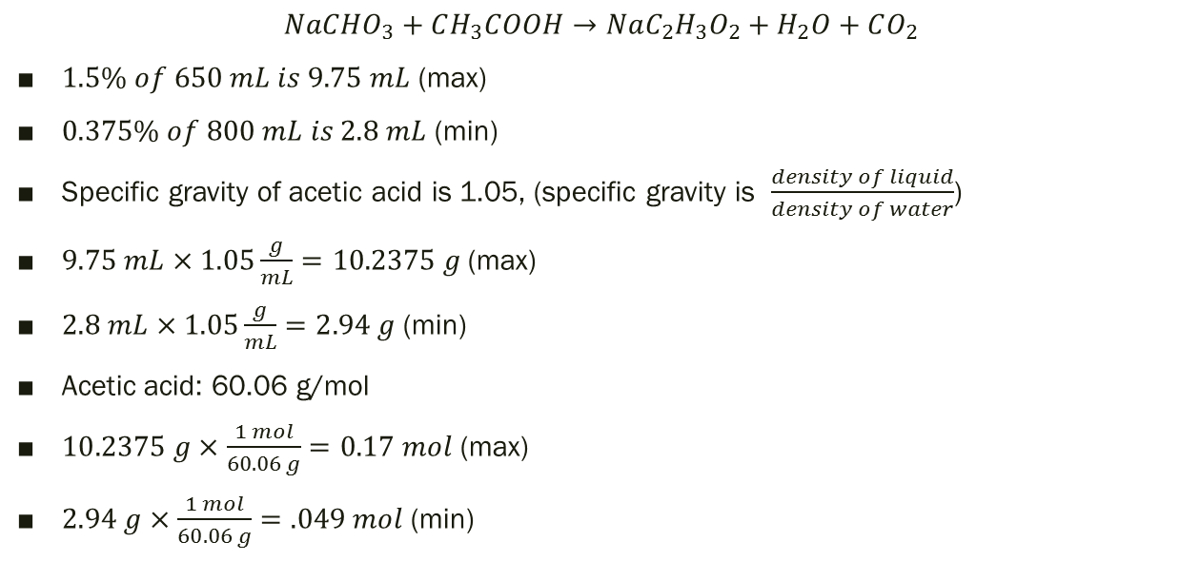
Chemical Calculations
$$NaCHO_{3}+CH_{3}COOH→NaC_{2}H_{3}O_{2}+H_{2}O+CO_{2}$$
$1.5\% of 650 mL is 9.75 mL$ (max)
$0.375\% of 800 mL is 2.8 mL$ (min)
Specific gravity of acetic acid is 1.05, (specific gravity is $\frac{density of liquid}{density of water}$)
$9.75 mL×1.05\frac{g}{mL}=10.2375 g$(max)
$2.8 mL×1.05\frac{g}{mL}=2.94 g$ (min)
Acetic acid: 60.06 g/mol
$10.2375 g×\frac{1 mol}{60.06 g}=0.17 mol$ (max)
$2.94 g×\frac{1 mol}{60.06 g}=.049 mol$ (min)

Slide 24
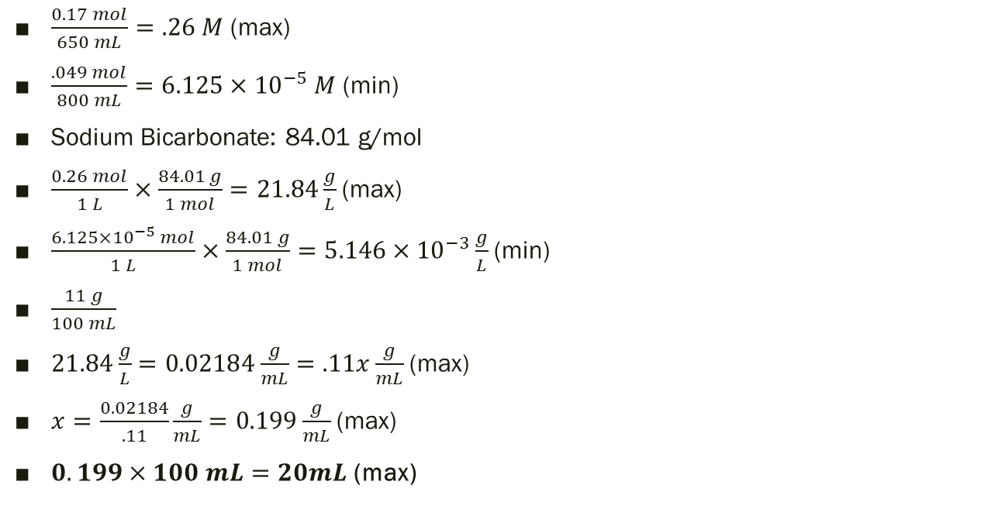
Chemical Calculations
$\frac{0.17 mol}{650 mL}=.26 M$ (max)
$\frac{.049 mol}{800 mL}=6.125×{10}^{−5} M$ (min)
Sodium Bicarbonate: 84.01 g/mol
$\frac{0.26 mol}{1 L}×\frac{84.01 g}{1 mol}=21.84\frac{g}{L}$ (max)
$\frac{6.125×{10}^{−5} mol}{1 L}×\frac{84.01 g}{1 mol}=5.146×{10}^{−3}\frac{g}{L}$ (min)
$\frac{11 g}{100 mL}$
$21.84\frac{g}{L}=0.02184\frac{g}{mL}=.11x\frac{g}{mL}$ (max)
$x=\frac{0.02184}{.11}\frac{g}{mL}=0.199\frac{g}{mL}$ (max)
$0.199×100 mL=20mL$ (max)
Sodium carbonate: (Na2CaO3): pH: 8.4
Sodium bicarbonate: (NaHCO3): pH: 11.6

Slide 25
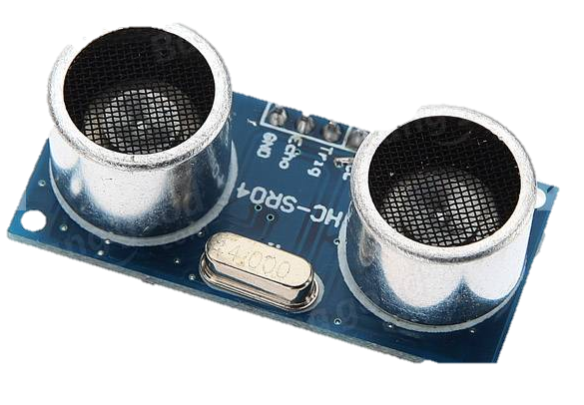
Sensory capability
3 HC-SR04 Ultrasonic range sensor used to detect obstacles in a cone
Has 3 lines of vision and avoids obstacles based on how close things are
APC 220 used to communicate to OSV
Will relay positional data of both OSV and the objective
OSV will then do calculations on where it is and where it needs to go
pH meter for Arduino, used to measure pH of the water
Will also be used in a closed feedback loop to neutralize solution

Slide 26
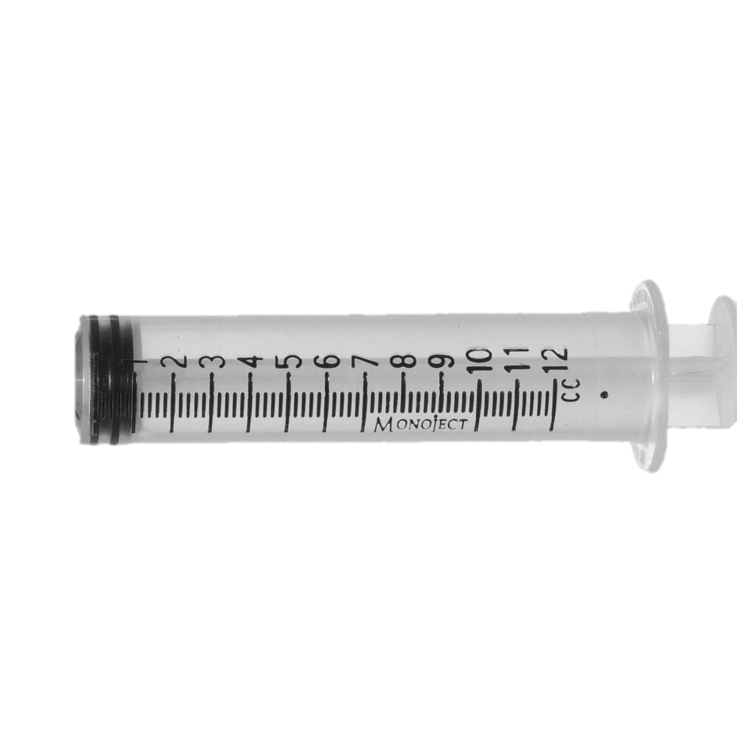
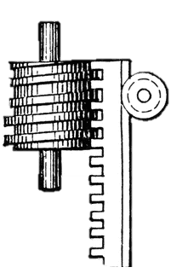
Actuation devices
The Vex 393 Motor will be used to depress the syringe through a rack and a worm gear
A rubber band can be used to pull the sampling syringe, and a solenoid will be used to hold the syringe in place until a sample needs to be drawn

Slide 27
Basic Circuit Diagram
Ultrasonic Sensors
Pump
M
M
APC220
Romeo
Board
pH
Meter
12V 2200mAh Battery
7.2V 1600mAh Battery
H-Bridge
Neutralizing dispenser motor
M
M
Lifting Platform motor

Slide 28

Control algorithm - Locomotion
Methods:
turn(angle)
moveForward(x, spd)
moveBack(x, spd)
detect(sensor)
Landing
Zone

Slide 29
Control algorithm – Mission objectives
Methods:
lowerPlatform()
getSample()
readpH()
transmit(pH)
neutralize(pH)
-readpH()
-dispenseBase(mL)
-agitate(duration)
-delay(ms)
Sampling tube
Base dispenser
pH meter
Pump
Chemical pool
Chemical Pool

Slide 30
Control algorithm – Mission objectives
Methods:
lowerPlatform()
getSample()
readpH()
transmit(pH)
neutralize(pH)
-readpH()
-dispenseBase(mL)
-agitate(duration)
-delay(ms)
Pump
Chemical Pool

Slide 31
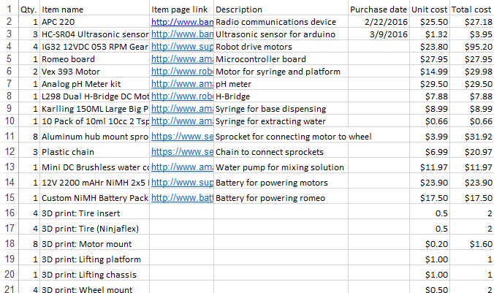
Bill of Materials (Estimated)
Total: $347.15

Slide 32
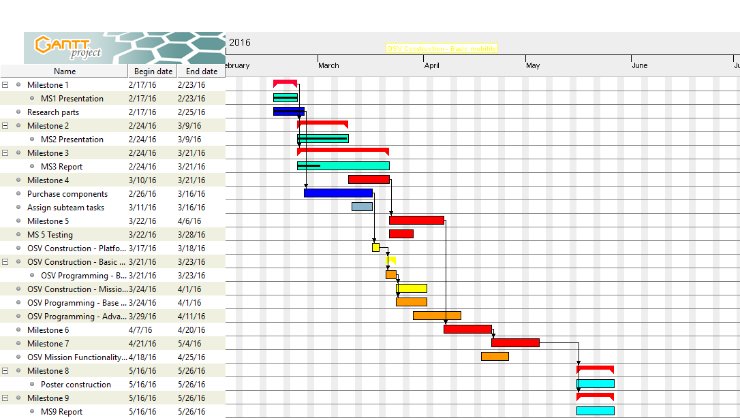
Updated Gantt Chart

Slide 33
Questions?

